Slide 1
CSE322
Mealy and Moore Machine
Lecture #4

Slide 2
Null Transition
An NFA with null transition is allowed to make transition not only on input from the alphabet but also with null input, i.e. without any input symbol. This transition without input is called null transition.

Slide 3
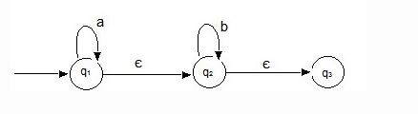
Null Transition

Slide 4
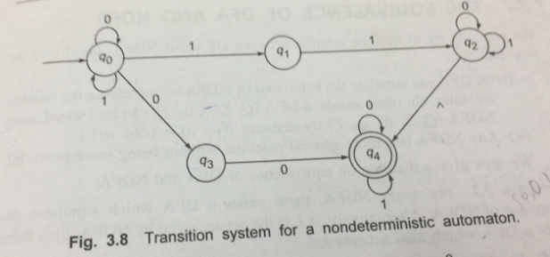
Null Transition

Slide 5
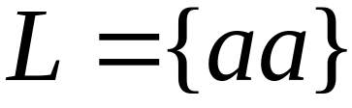


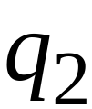


Language accepted:

Slide 6


Lambda Transitions

Slide 9
(read head does not move)

Slide 11

all input is consumed
“accept”
String is accepted

Slide 12
Rejection Example

Slide 14
(read head doesn’t move)

Slide 15
No transition:
the automaton hangs

Slide 16

Input cannot be consumed
“reject”
String is rejected

Slide 17
Language accepted:

Slide 18


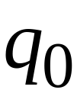
Another NFA Example

Slide 19
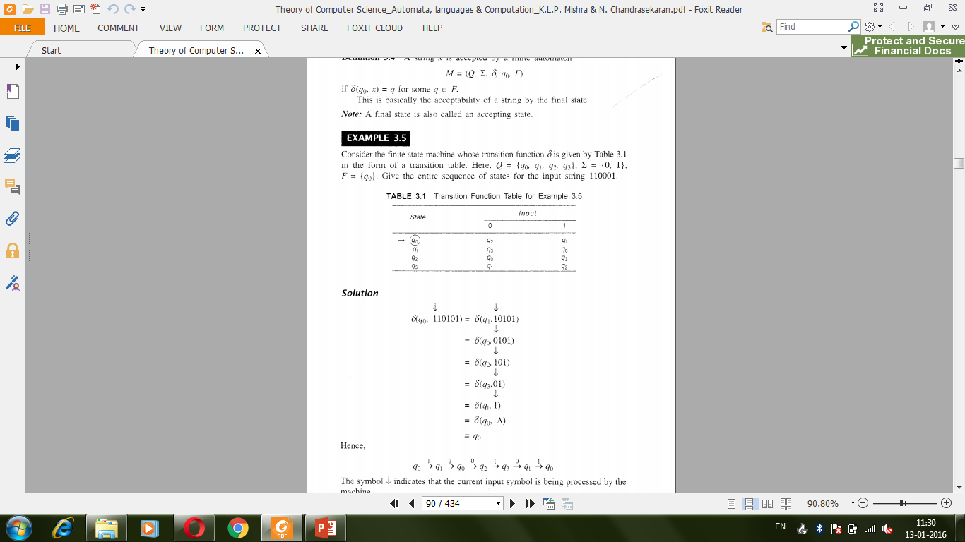
How to accept a string

Slide 20
How to accept a string

Slide 21


Slide 24
“accept”

Slide 25
Another String

Slide 32
“accept”

Slide 33
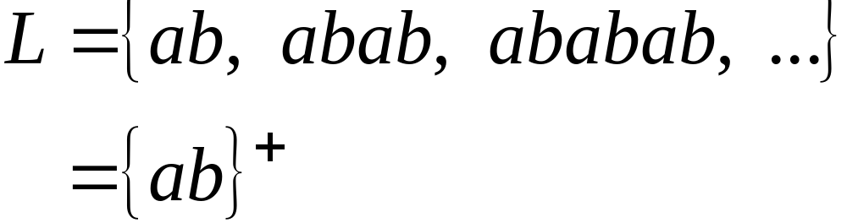
Language accepted

Slide 34

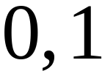

Another NFA Example

Slide 35
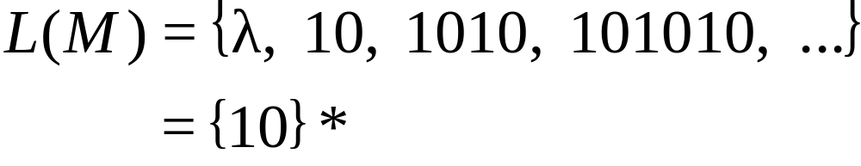
Language accepted
(redundant
state)

Slide 36
Mealy and Moore Model
In finite Automata acceptability was decided on the basis of reach ability of the final state by initial state.
This restriction are removed and new model is given in which output can be chosen from some other alphabet.
The value of the output function Z(t) is a function of present state q(t) and the present input x(t)
Z(t) = λ(q(t), x(t)) Mealy Machine
The value of the output function Z(t) is a function of present state q(t) only and is independent of the current input
Z(t) = λ(q(t)) Moore Machine
Notes:
Mealy and Moore Model

Slide 37
Moore Machine
Moore Machine is six-tuple (Q,∑,∆,δ,λ,q₀):
Q is a finite set of states
∑ is the input alphabet
∆ is the output alphabet
δ is the transition function from ∑ X Q into Q
λ is the output function mapping Q into ∆ and
q₀ is the initial state
Notes:
Mealy and Moore Model

Slide 38
Mealy Machine
Mealy Machine is six-tuple (Q,∑,∆,δ,λ,q₀):
Q is a finite set of states
∑ is the input alphabet
∆ is the output alphabet
δ is the transition function from ∑ X Q into Q
λ is the output function mapping ∑ X Q into ∆ and
q₀ is the initial state
Notes:
Mealy and Moore Model

Slide 39
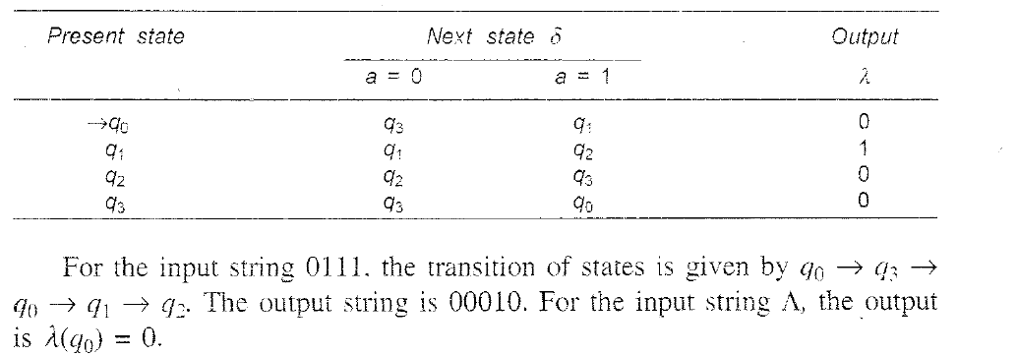
Example of Moore Machine
Notes:
Mealy and Moore Model

Slide 40
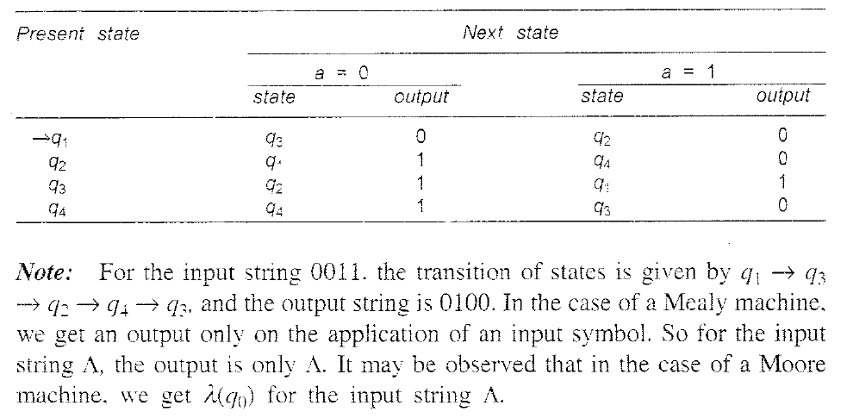
Example of Mealy Machine
Notes:
Mealy and Moore Model

Slide 41
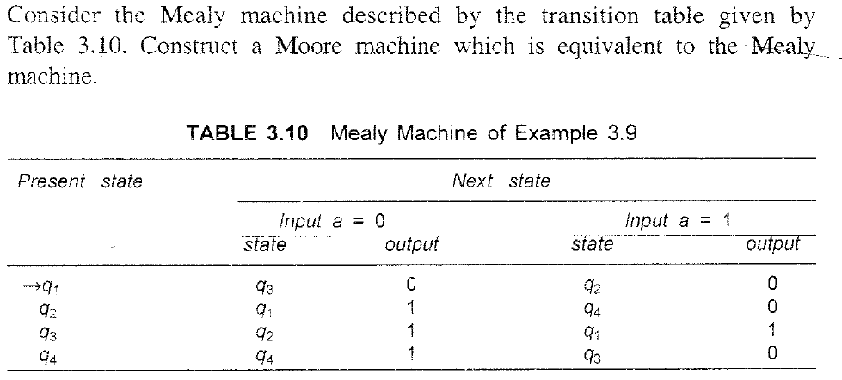
Transforming Mealy to Moore Machine
Notes:
Mealy and Moore Model

Slide 42


Slide 43
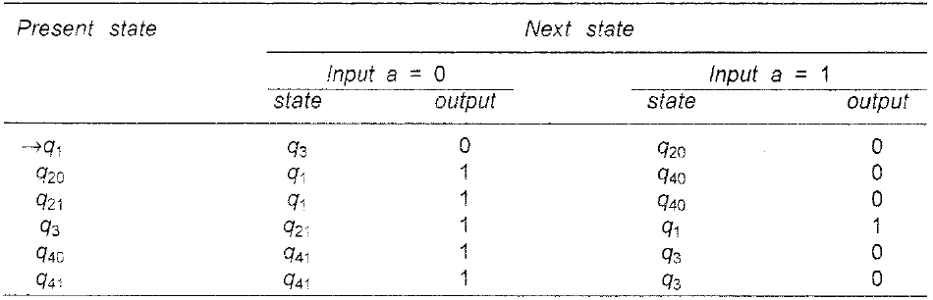
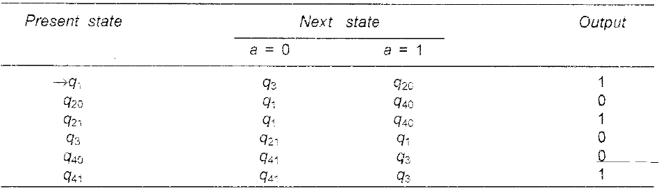
Solution
Notes:
Mealy and Moore Model

Slide 44
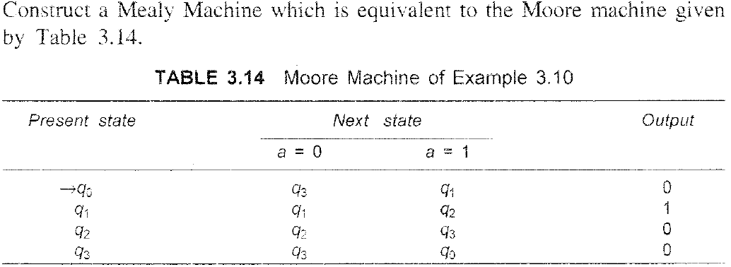
Transforming Moore to Mealy Machine
Notes:
Mealy and Moore Model

Slide 45
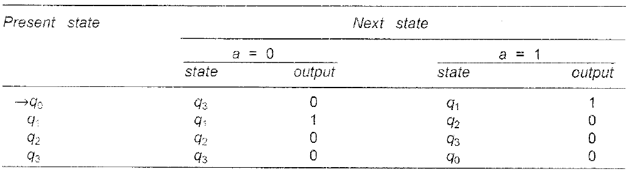
Solution
Notes:
Mealy and Moore Model

Slide 46
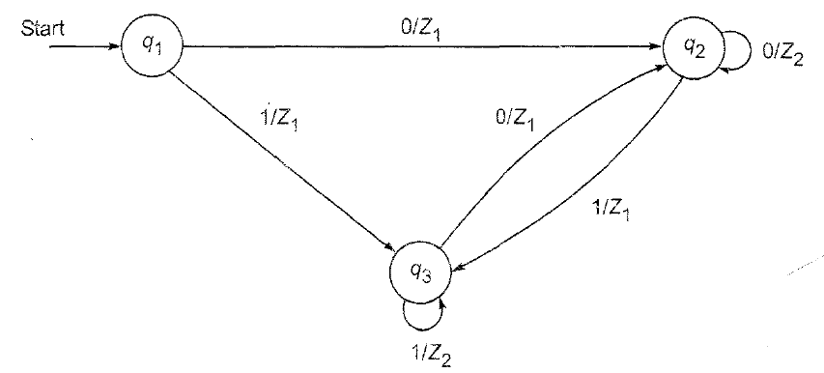

Slide 47
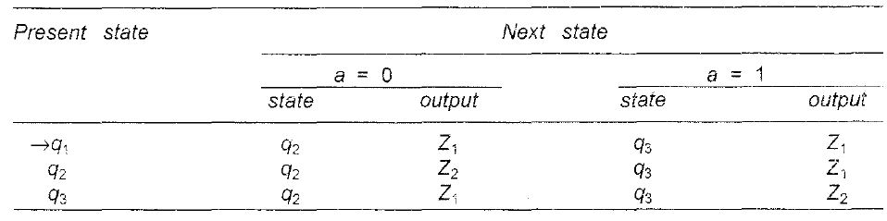
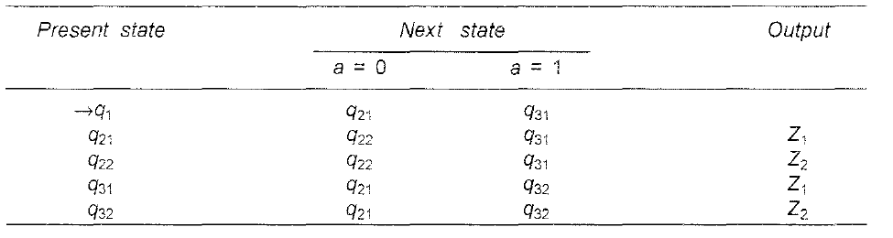
Solution
Notes:
Solution

Slide 48
Answer Justification
Here there is no output associated with q1 so, It will be ^.
q2 is associated with 2 outputs z1 and z2 so 2 states will be considered q21,q22.
q3 is associated with 2 outputs z1 and z2 so 2 states will be considered q31,q32

Slide 49
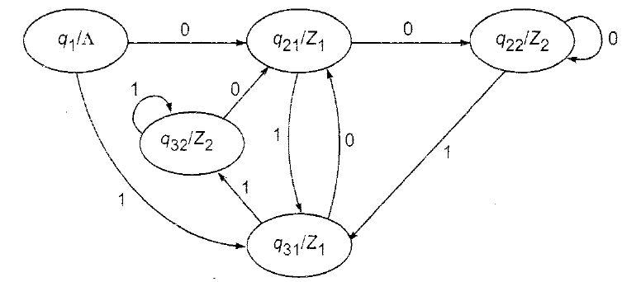
Answer

Slide 50
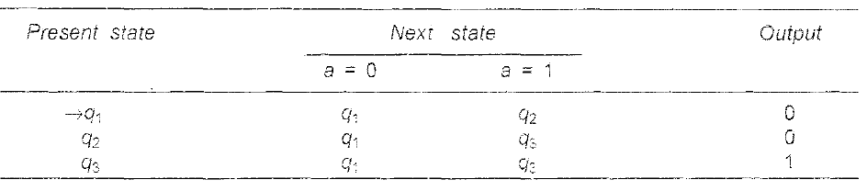

Slide 51
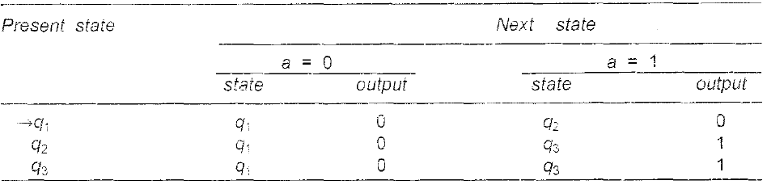
Solution
Notes:
Solution

Slide 52
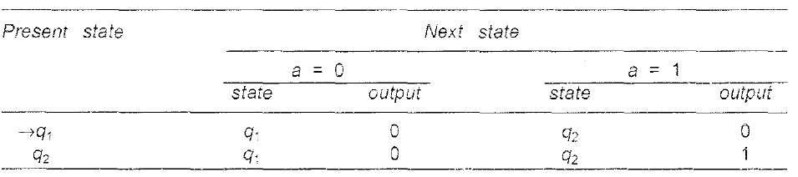
Convert it to Moore Machine

Slide 53
Convert it to mealy machine

